Slide 1
The Bigger Picture
Language Models

Slide 2
Course Contents
Deep Learning
Transformer
Finetuning
Agents
The Bigger Picture
Context Engineering
Instruction Tuning
LLMs

Slide 3
This Part: The Bigger Picture
historical context
current research directions
discussion

Slide 4
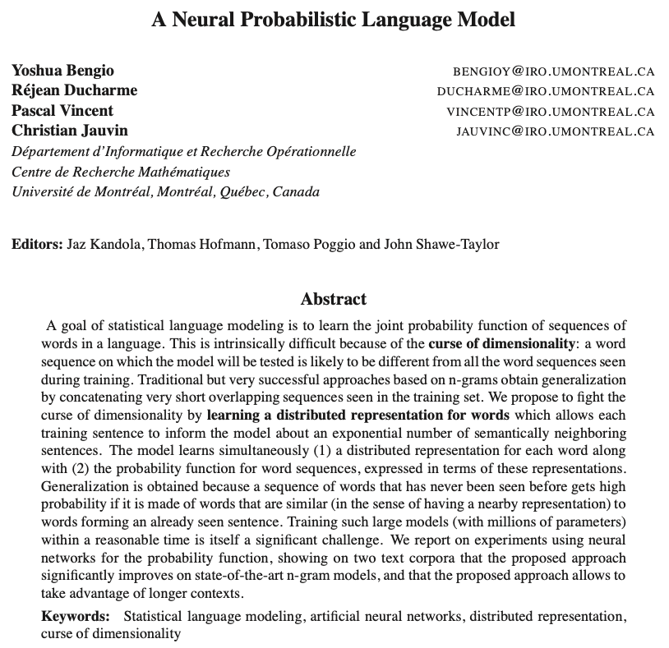
Neural Networks as Language Models
2003

Slide 5
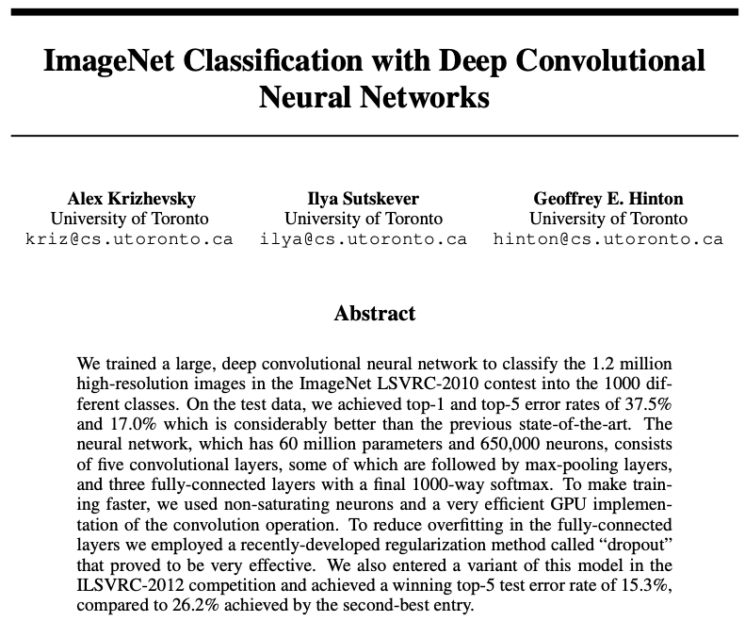
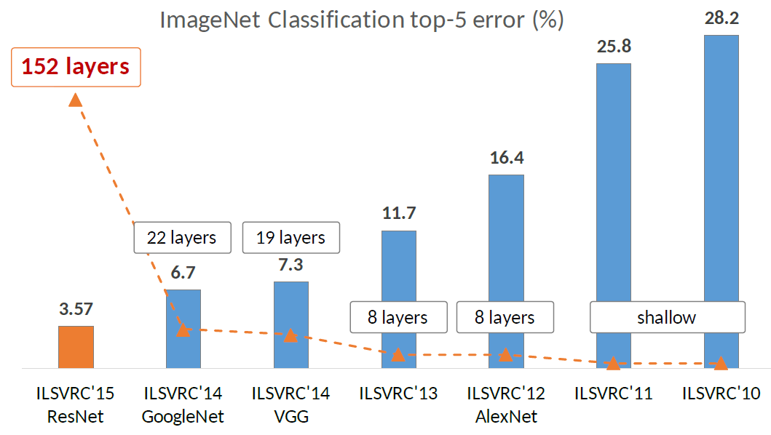
Deep Learning Rises
2012

Slide 6
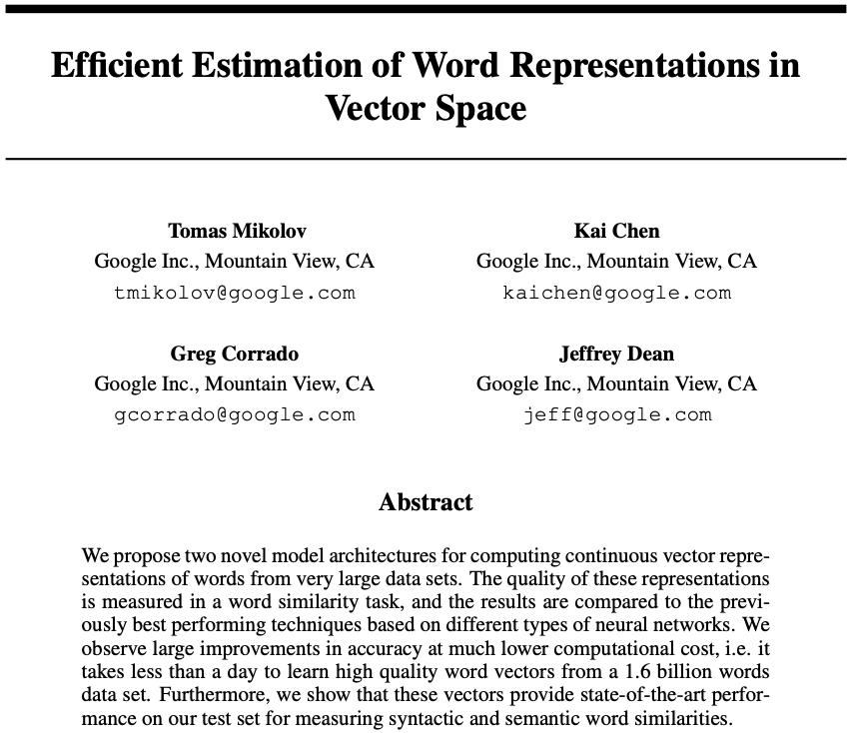
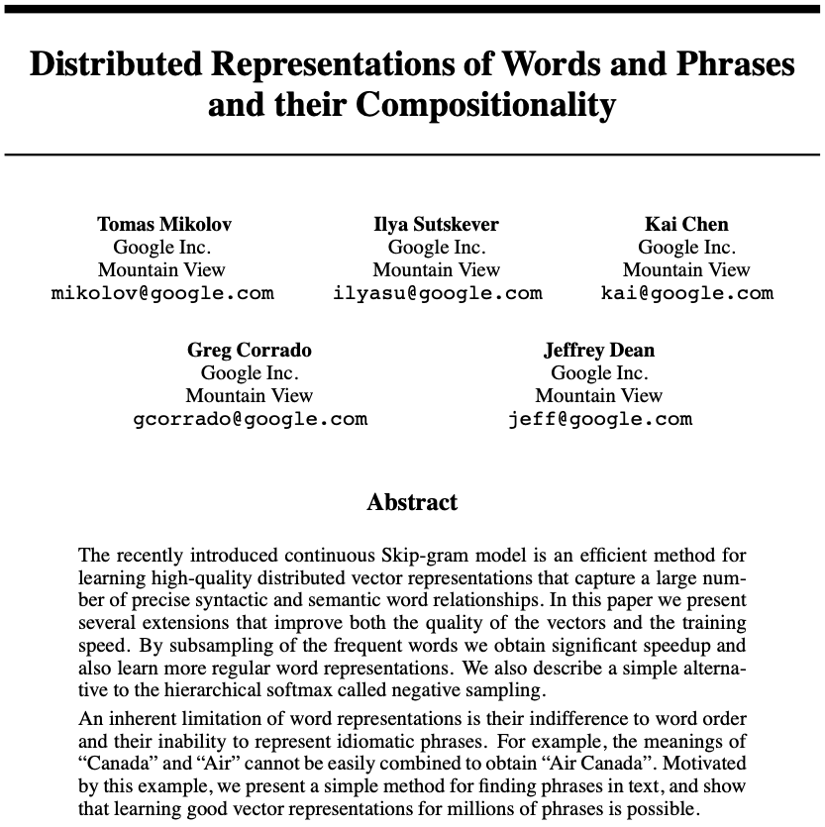
Word Embeddings
2013

Slide 7
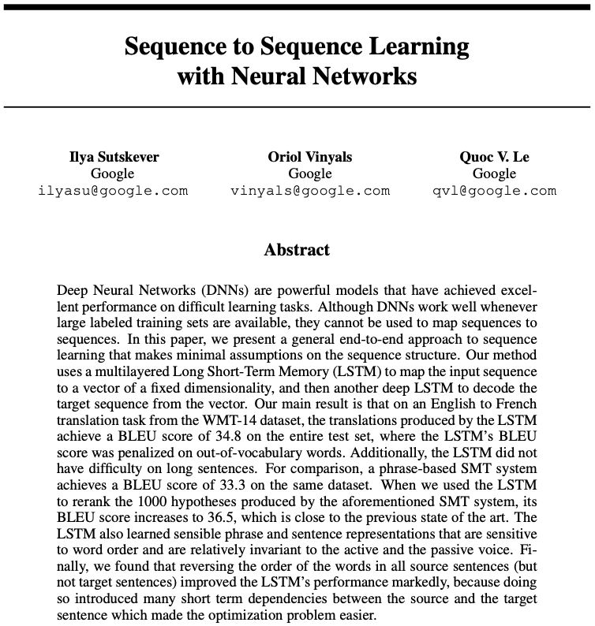
Machine Translation
2014
Once there were RNNs …

Slide 8
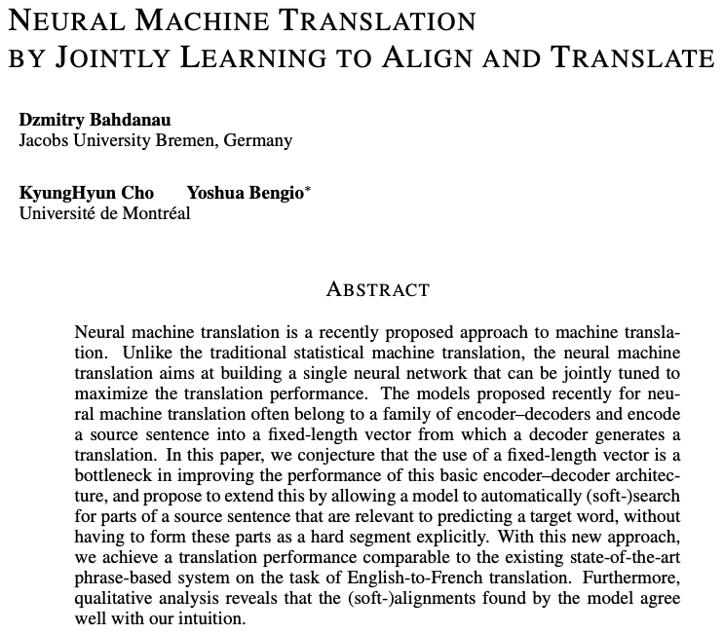

Attention Mechanism
2015

Slide 9
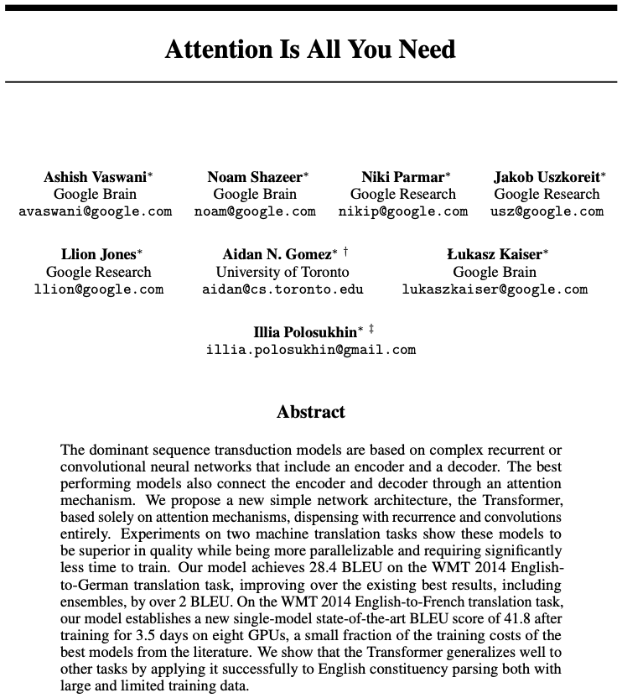

Transformers Take Over
2017

Slide 10
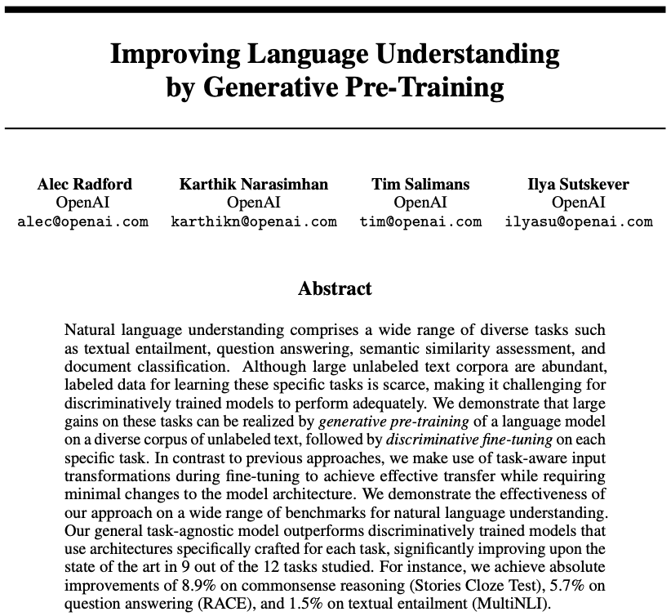
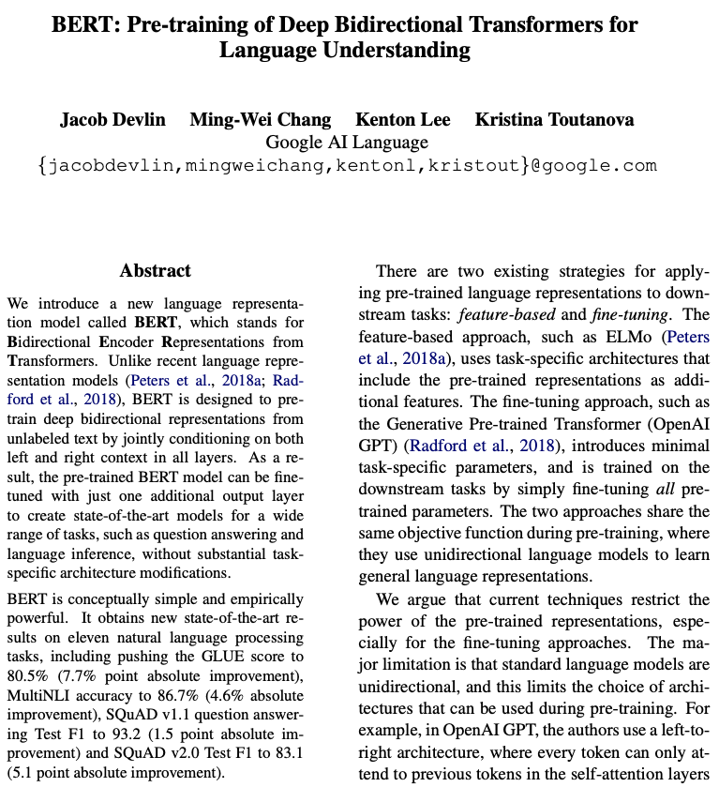
GPT & BERT
2018
self-supervised pretraining followed by supervised finetuning

Slide 11
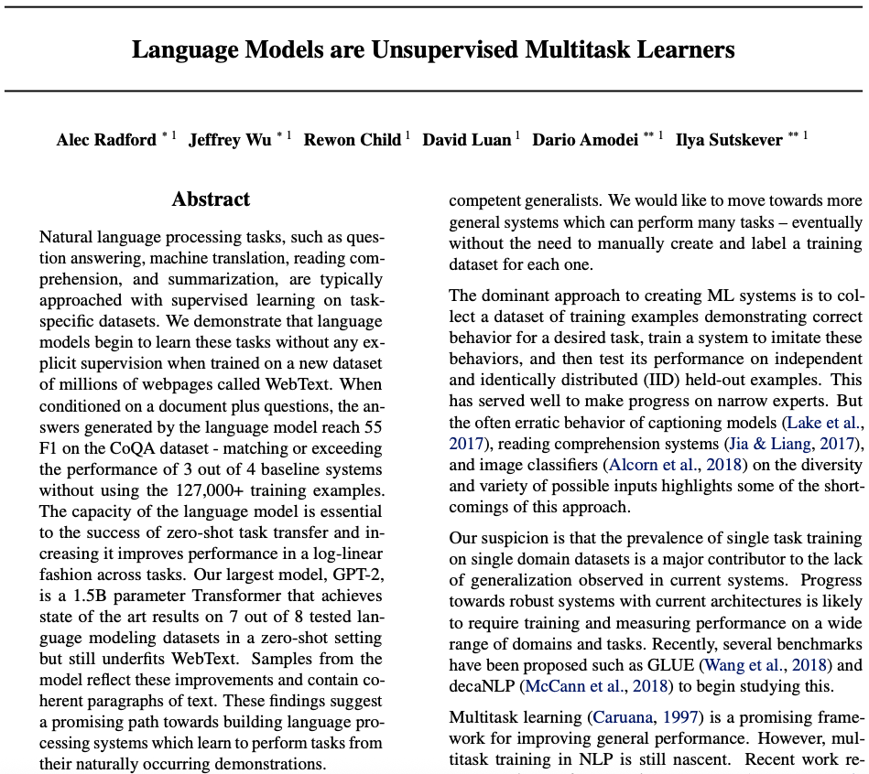
Prompting: GPT-2
2019
zero-shot & few-shot learning

Slide 12
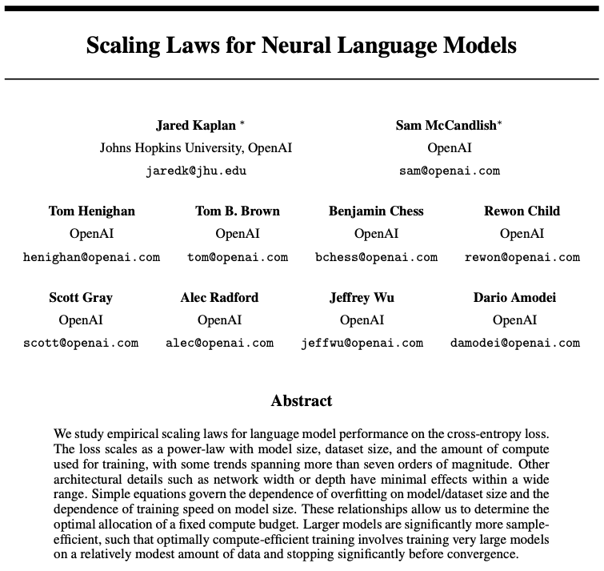
Scaling Laws
2020

Slide 13
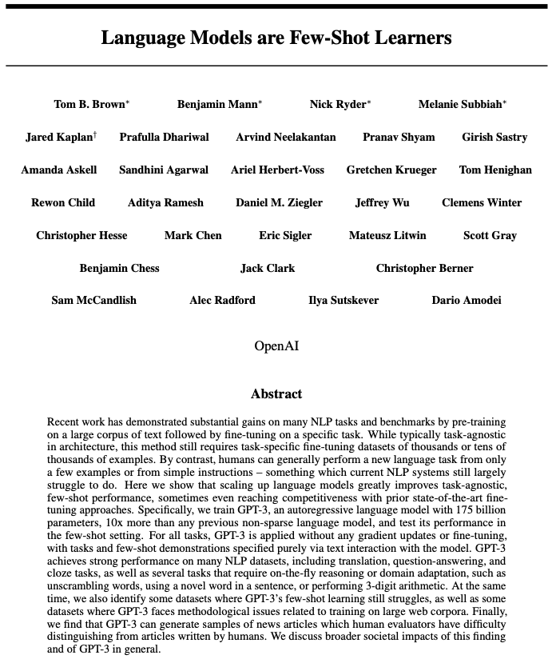
GPT-3
2020
175 billion parameters

Slide 14
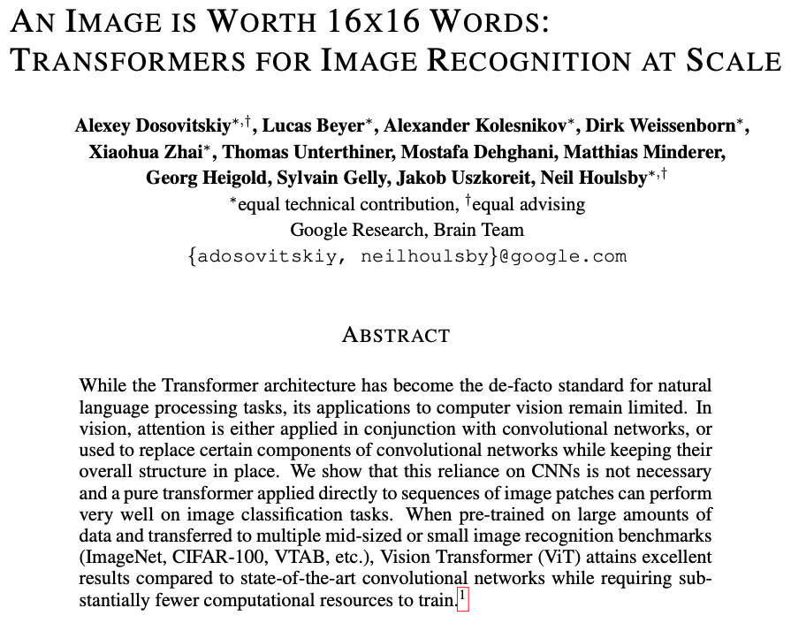

Vision Transformer
2021

Slide 15
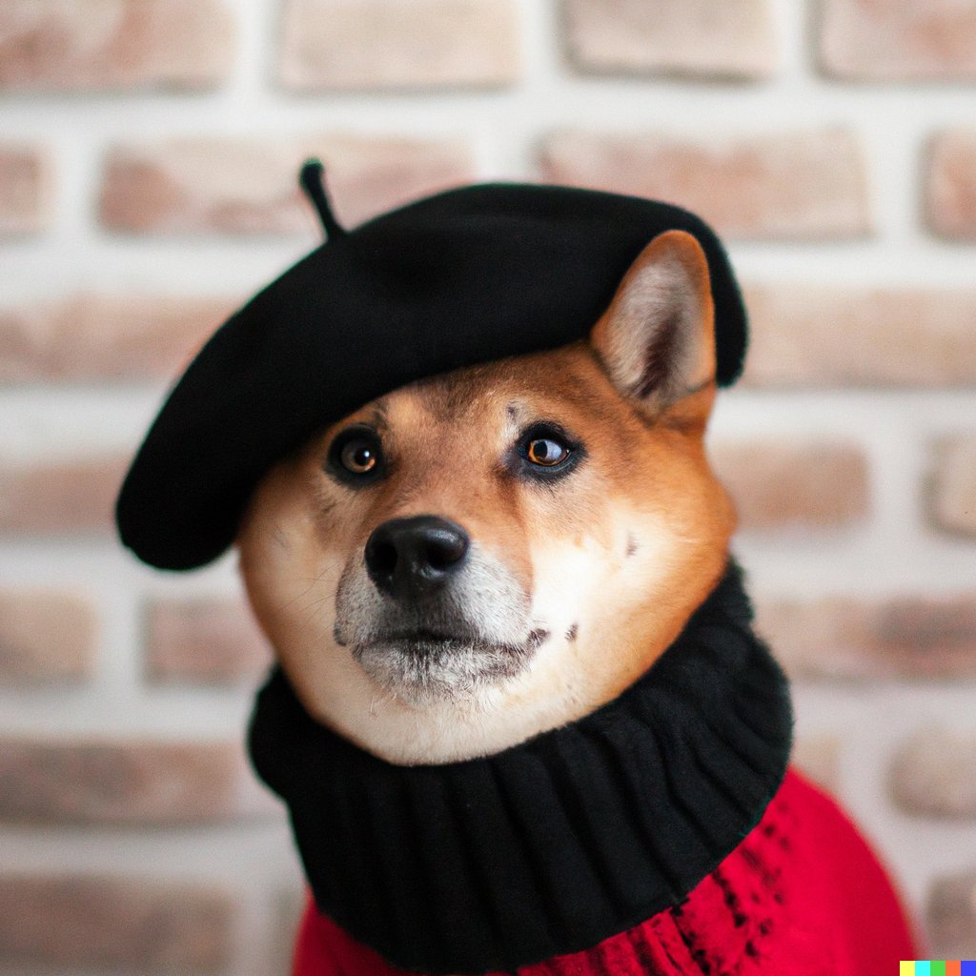
Text-to-Image: DALL-E
2021
“A Shiba Inu dog wearing a beret and black turtleneck”

Slide 16
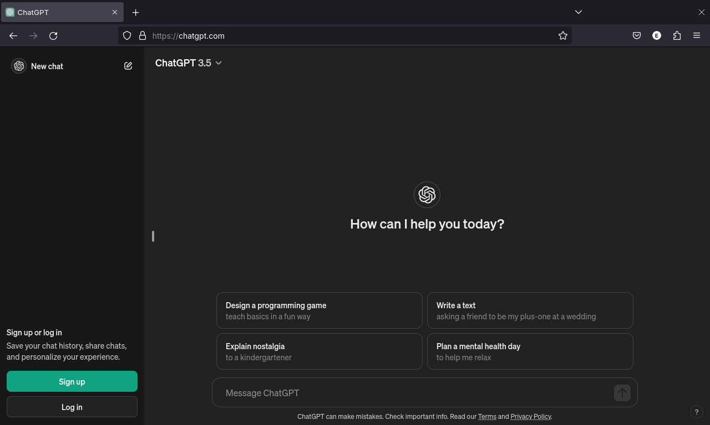
Takeoff: ChatGPT
2022

Slide 17
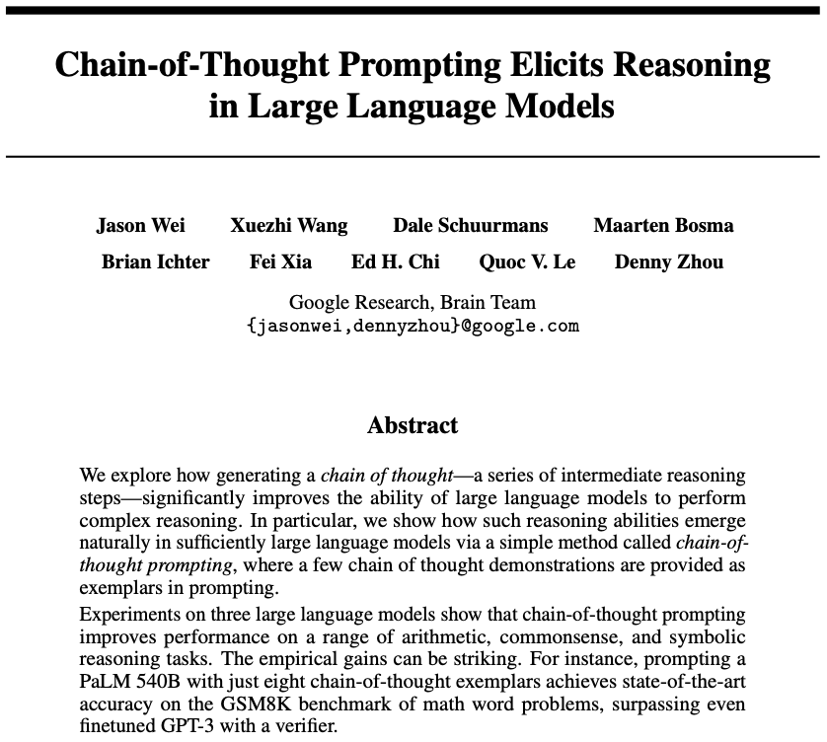
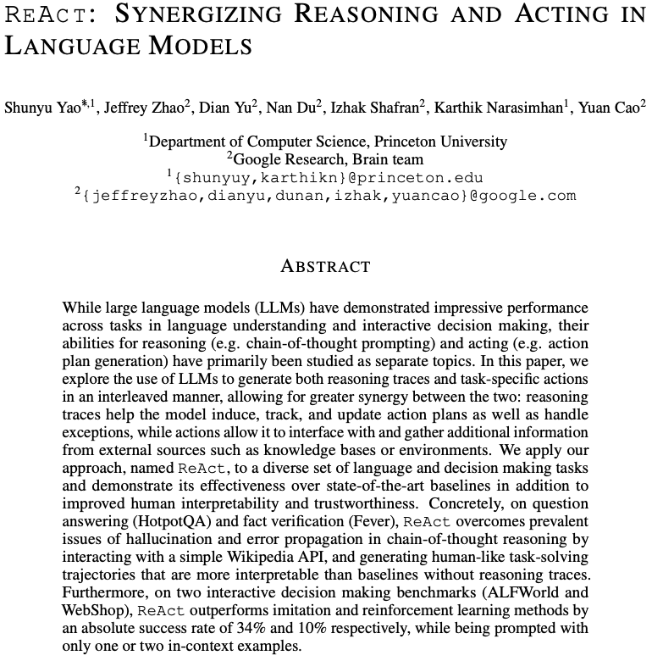
Reasoning & Tool Use
2023

Slide 18
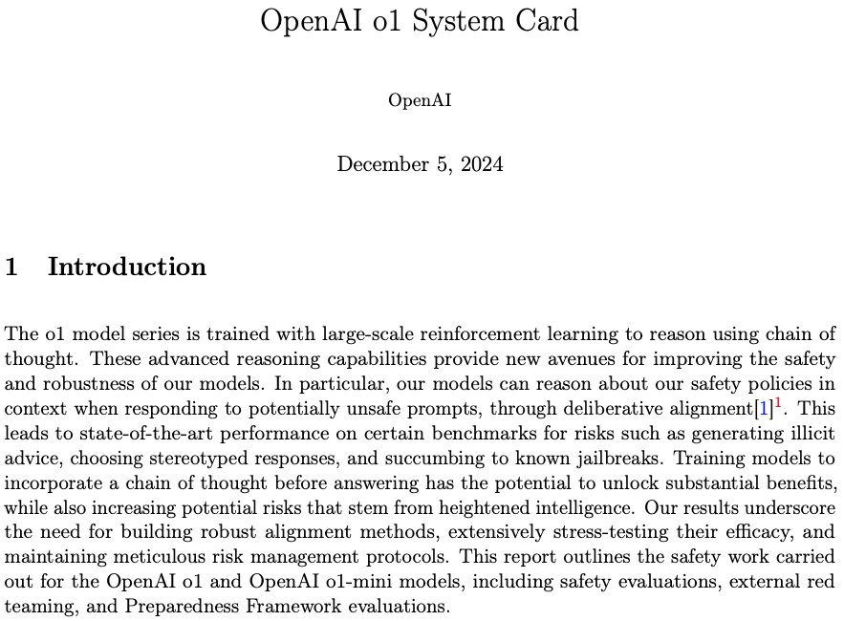
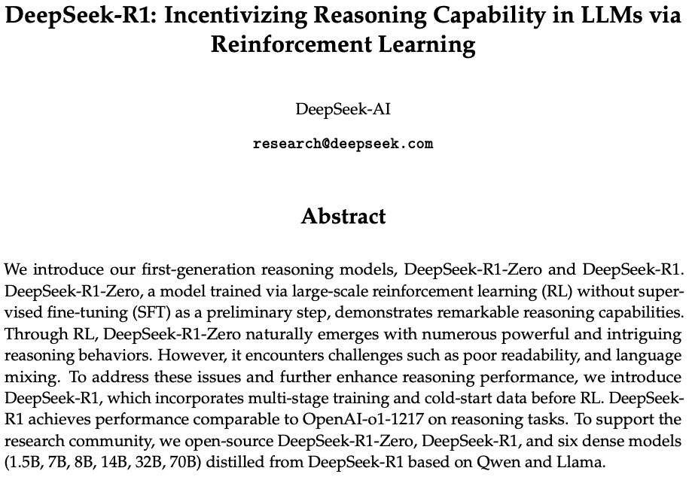
Reasoning Models
2025
test-time scaling

Slide 19
Active Research Areas
autonomous agents: memory, planning, reasoning, tool use
multimodal models: unification of text, image, video, audio
training efficiency and long-context models
expert models tuned for specific domains or tasks (SLMs)
transformer alternatives (e.g., state-space models like Mamba)

Slide 20
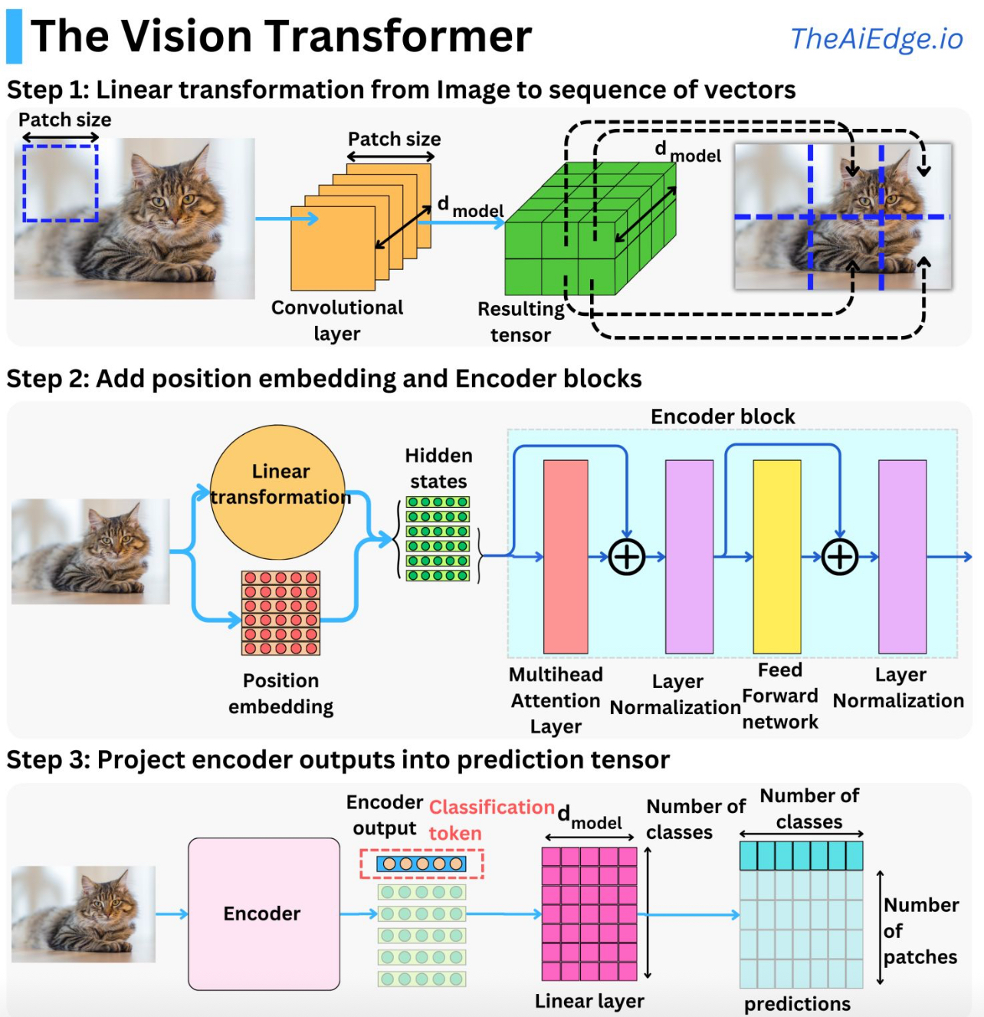
Image Classification with Vision Transformer
source
formulation as sequential problem:
split image into patches (tokens) and flatten, add positional embeddings
processing by transformer encoder:
pretrain with image labels, fine-tune on specific data set

Slide 21
Vision Language Models
visual encoder (e.g., CNNs, vision transformers):
extracts high-level features from images or video frames
text encoder (e.g., BERT, GPT):
processes and understands textual data
multimodal fusion module:
combines visual and textual representations
common techniques: cross-attention, concatenation, or joint embedding spaces
decoder or task head:
outputs results for specific tasks like image captioning or visual question answering

Slide 22

Combination of Vision and Text
example: CLIP (Contrastive Language-Image Pre-training)
learn image representations by predicting which caption goes with which image (pretraining)
→ zero-shot transfer (e.g., for image classification)
transformer
ViT
(or ResNet)
cosine similarity
joint embedding

Slide 23
Deep Learning for Generative AI
Depending on the application, there are currently two dominant approaches for generative AI:
text generation: decoder LLMs (autoregressive generation)
image synthesis: diffusion models
note the difference between image synthesis and multimodal understanding in LLMs (images as additional input sequences to transformer, tokenized by splitting into patches)

Slide 24

Image Synthesis
example: DALL-E 2
idea: generate new images as variations of training data (same distribution)
usually conditioned on text (prompt)
can be done with autoregressive models
but diffusion models result in way higher photorealism

